Slide 1
Citi Bike Data Analysis and time Predictions
By Darshan Patel
Fordham University
CISC 5950 – Big Data Programming
Prof. Yijun Zhao

Slide 2
Data Features
This dataset is a collection of system data of all Citi bike rides in NYC,
Trip Duration (seconds)
Start Time and Data
Start Station Name, ID, Latitude/Longitude Coordinates
End Station Name, ID, Latitude/Longitude Coordinates
Bike ID
User Type (Customer, Subscriber)
Gender
Year of Birth

Slide 3
Data Files
Citi Bike publishes monthly data
Use 10 months worth of data, from January 2018 to October 2018
Together, it has a file size of 2.83 gigabytes
Use Spark to analyze 4 questions
Use Spark MLlib to make a linear regression model and decision tree model

Slide 4
Questions to Answer
What are the top 10 destinations for Citi bikers based on when they leave? What areas are popular?
What is the distribution of user types per age?
What is the distribution of bike uses depending on the time of, type of day (weekend/weekday) and gender?
What is the the average distance traveled by age and gender? Their average speed?
Linear regression model to predict time to reach a destination based on distance between two stations
Decision tree model to predict time to reach a destination based on station names, age, gender and usertype

Slide 5
Data Preprocessing
Breakdown of Gender
Male – 0.675
Female – 0.234
Unknown - 0.089
Male and females make up 92% of the dataset. Drop the observations with the unknown gender.
Ages of bikers ranged from 16 to 133 !
Oldest ‘verified’ living person on Earth today is only 115 years old, and in Japan..
It was found that there was a huge declination in bikers starting at the age of 63
For analysis, drop observations that had an age of over 65

Slide 6
Data Preprocessing
User Types
Customers – 1 or 3 day pass, 30 minute limit then upcharge
Subscribers – annual membership, 45 minute limit then upcharge
Many observations showed rides lasting over 2 hours
Many instances of rides lasting at least 1000 hour (~10 days)
For analysis, drop all observations who did not pay any upcharge

Slide 7
Data PREProcessing
A lot of columns were cleaned during this process
But not a lot of data was removed
Started with 15,271,479 observations
Ended with 13,189,633 observations
This is a 10.6% decrease in size

Slide 8
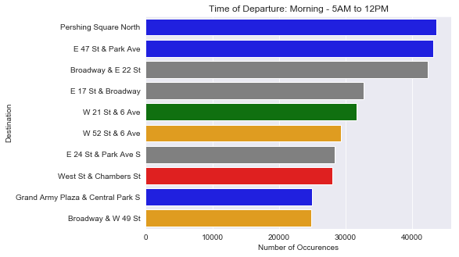
Question 1: Top 10 Destinations based on Time of Departure: Morning
Blue – Midtown East
Grey – Flatiron
Orange – Midtown West
Green – Chelsea
Red – Lower Manhattan
Brown – East Village
Purple – West Village
Midtown East and Flatiron
locations are popular

Slide 9
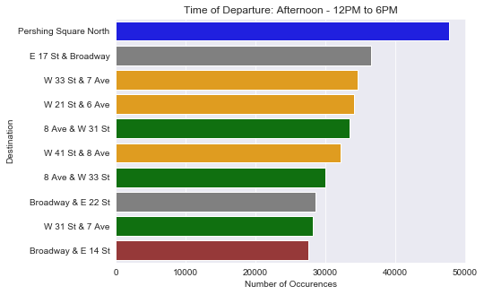
Question 1: Top 10 Destinations based on Time of Departure: Afternoon
Blue – Midtown East
Grey – Flatiron
Orange – Midtown West
Green – Chelsea
Red – Lower Manhattan
Brown – East Village
Purple – West Village
Midtown is still popular,
Pershing Square North is again at
Position 1

Slide 10
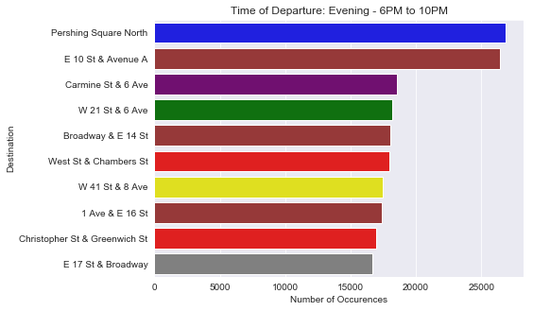
Question 1: Top 10 Destinations based on Time of Departure: EVENING
Blue – Midtown East
Grey – Flatiron
Orange – Midtown West
Green – Chelsea
Red – Lower Manhattan
Brown – East Village
Purple – West Village
Pershing Square North is
still popular!
More people are going to
East/West Village areas

Slide 11
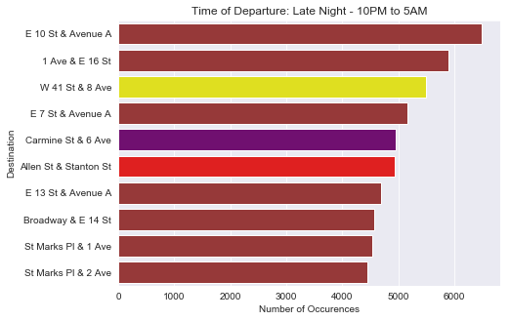
Question 1: Top 10 Destinations based on Time of Departure: Late night
Blue – Midtown East
Grey – Flatiron
Orange – Midtown West
Green – Chelsea
Red – Lower Manhattan
Brown – East Village
Purple – West Village
Most people bike to East/West Village
at this hour

Slide 12
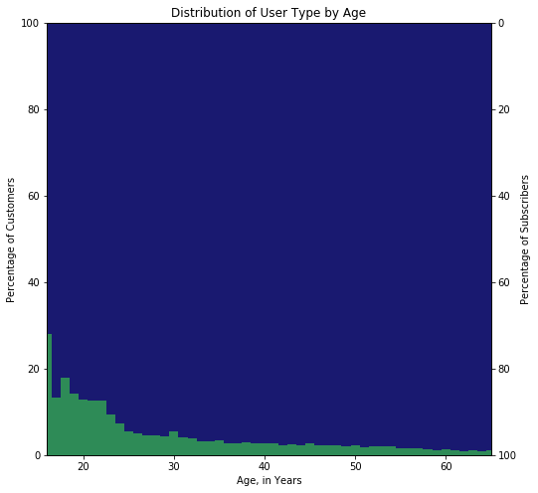
Question 2: What is the distribution of user types by age?
Young people are more likely to be customers, especially at the age of 16
Young people are not as committed to annual plans as the older generation

Slide 13
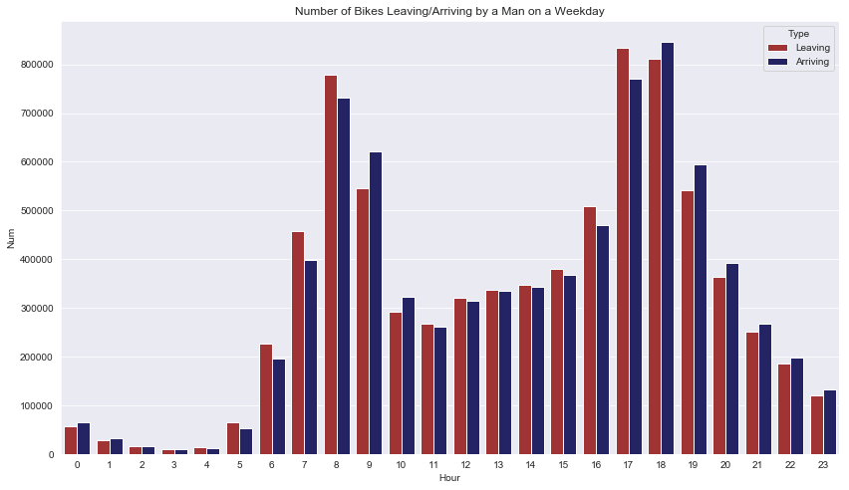
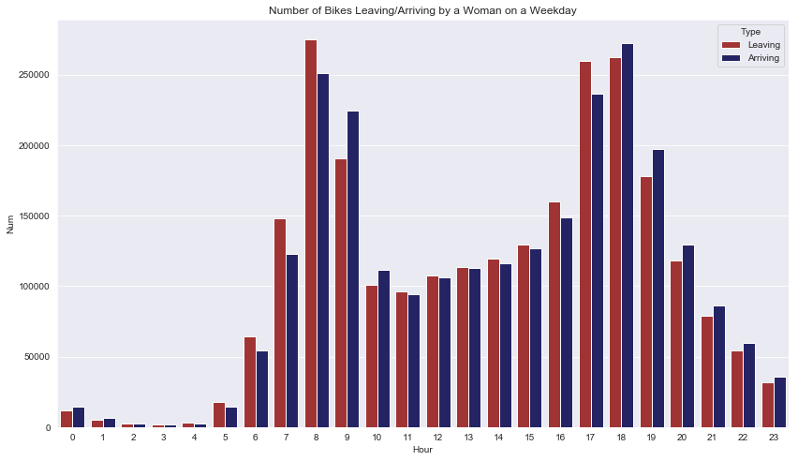
Question 3: Distribution of Bike Uses Depending on Type of Day and Gender : Weekday
Rush hours have heavy traffic, late night hours have little to no bikers

Slide 14
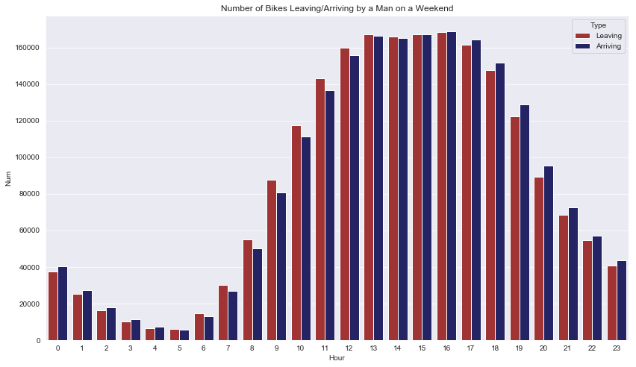
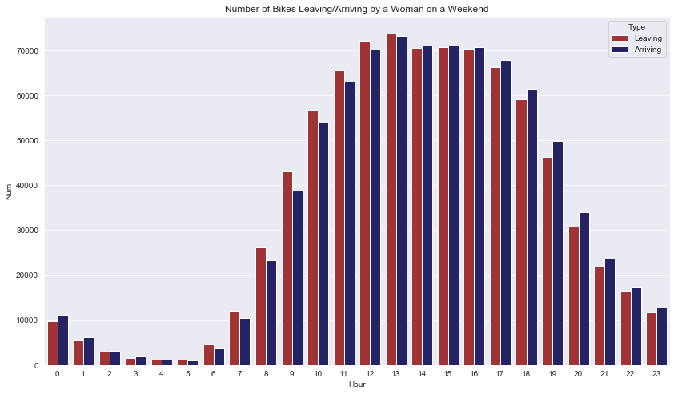
Question 3: Distribution of Bike uses depending on type of day and gender: Weekend
Wave-like distribution, highs around 2-3pm, late night has bikers out

Slide 15
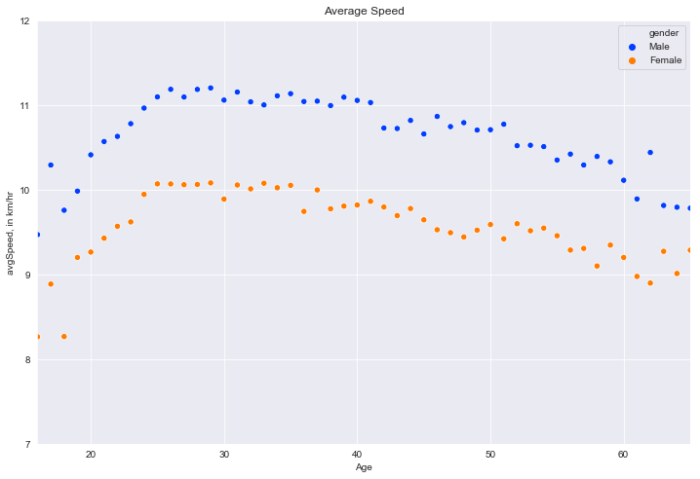
Question 4: Average Speed traveled by gender
Males on the average travel faster than women

Slide 16
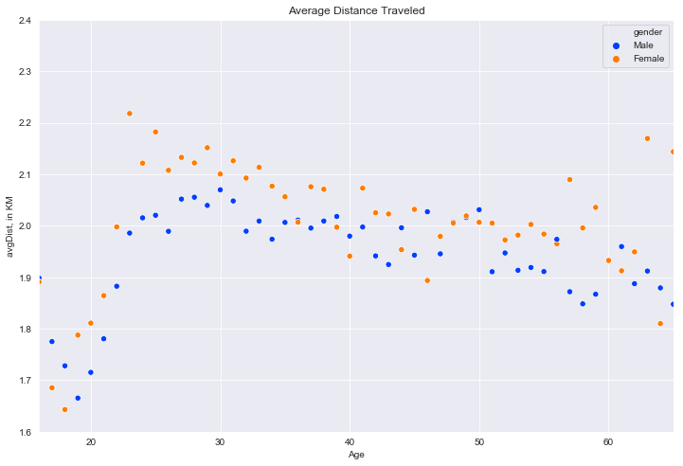
Question 4: average Distance Traveled by gender
Women tend to travel a longer distance on the average

Slide 17
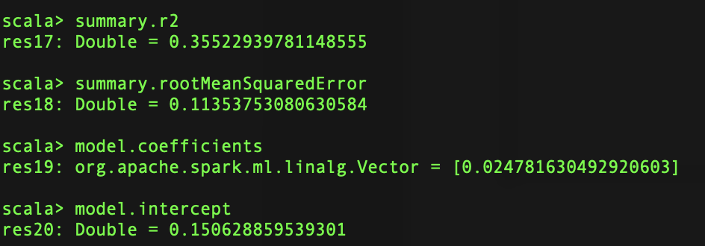
Linear regression model to predict time duration based on distance traveled
Ran LR on entire 13 million dataset (5 mins)
Feature: Haversine distance between 2 stations
Label: duration of trip
Conclusion: Model is not so good. Low R² value.
Try adding categorical features from the dataset or use trees.

Slide 18
Decision tree model to predict time to reach a destination based on station names, age, gender and usertype
Increasing depth of the tree gave better results on the testing set
Optimal depth of tree that does not overfit the data was not found due to hardware limitations at creation of tree of depth 14
(Spark can do up to depth 30.)
Conclusion: Decision tree of depth 13 is best for predicting time to reach a destination based on several features
Note: Each decision tree creation and evaluation took 5 mins.

Slide 19
Conclusions
Midtown gets heavy bike traffic during the day and afternoon while East Village gets the most bike traffic after midnight
Young people are more likely to be customers than old people
Bike traffic is heavy during rush hours for both men and women in the weekdays
Bike traffic is heavy in the afternoon for both men and women in the weekends
Men travel faster on the average while women travel longer on the average
Linear regression model did not predict time of travel as well as the decision tree model
Decision tree model can improve with hardware improvements

Slide 20
Conclusion
Thank you.

